Slide 1


Rare events probability estimation
Gaëtan Blondet, Phimeca Engineering SA
‘HPC and Uncertainty Treatment – Examples with Open TURNS and Uranie’
EDF – Phimeca – Airbus Group – IMACS – CEA
PRACE Advanced Training Center – May, 10-12 2021

Slide 2

Outline
Problem definition
Brute-force estimation using Monte Carlo sampling
Most-probable-failure-point(s)-based methods

Slide 3
Outline
Problem definition
Brute-force estimation using Monte Carlo sampling
Most-probable-failure-point(s)-based methods

Slide 4

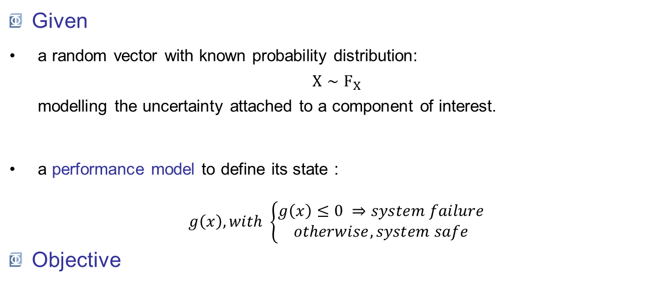
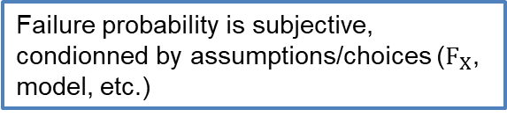
Problem definition
Given
a random vector with known probability distribution: $X∼F_{X}$ modelling the uncertainty attached to a component of interest.
a performance model to define its state :
$$g\left(x\right), with \left\{\begin{aligned}g\left(x\right)≤0 ⇒system failure \\ otherwise, system safe\end{aligned}\right.$$
Objective
To quantify the component safety level with a failure probability.
Failure probability is subjective, condionned by assumptions/choices ($F_{X}$, model, etc.)

Slide 5
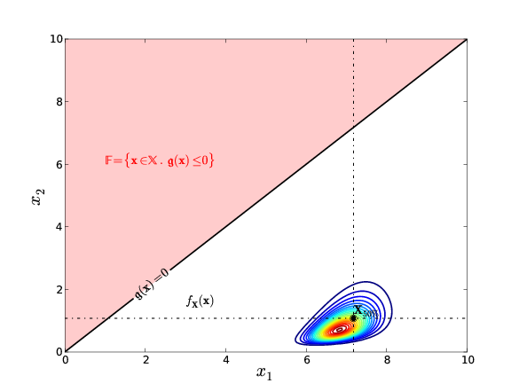



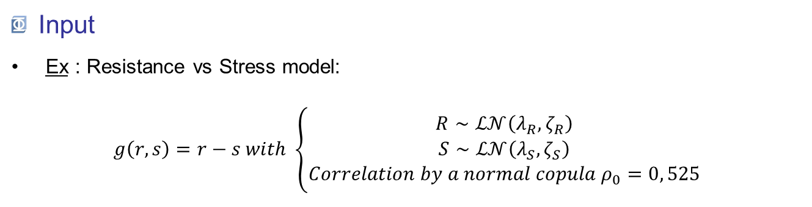
Problem definition
Input
Ex : Resistance vs Stress model: $g\left(r,s\right)=r−s with \left\{\begin{aligned}R∼ℒ𝒩\left(λ_{R},ζ_{R}\right) \\ S∼ℒ𝒩\left(λ_{S},ζ_{S}\right) \\ Correlation by a normal copula{ ρ}_{0}=0, 525\end{aligned}\right.$
Failure domain
$$p_{f}=ℙ\left[g\left(X\right)≤0\right] \\ p_{f}=ℙ\left[X∈𝔽\right]$$
$p_{f}$ is often small !
Limit-state function
Safe domain

Slide 6
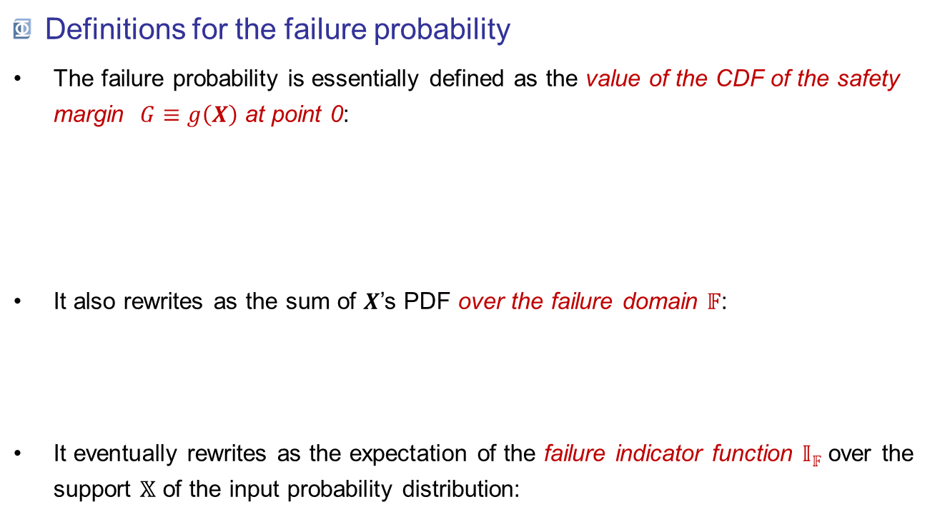
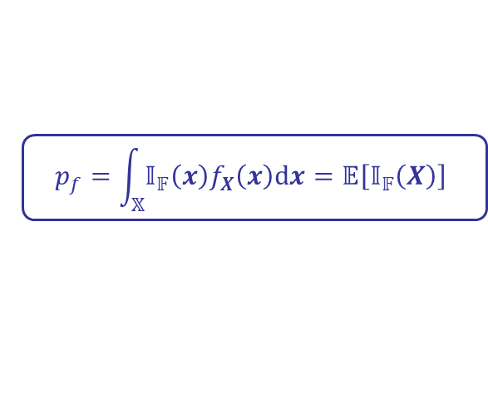
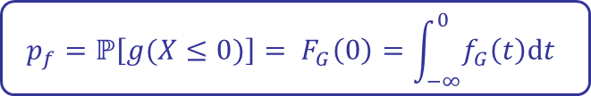
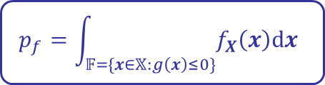
Problem definition
Definitions for the failure probability
The failure probability is essentially defined as the value of the CDF of the safety margin $G≡g\left(X\right)$ at point 0:
It also rewrites as the sum of $X$’s PDF over the failure domain 𝔽:
It eventually rewrites as the expectation of the failure indicator function 𝕀_{𝔽} over the support 𝕏 of the input probability distribution:
$${p_{f}=ℙ\left[g(X≤0)\right]= F}_{G}\left(0\right)=\int_{−∞}^{0}{f_{G}\left(t\right)dt}$$
$$p_{f}=\int_{𝔽=\{x∈𝕏:g\left(x\right)≤0\}}{f_{X}\left(x\right)dx}$$
$$p_{f}=\int_{𝕏}{{𝕀_{𝔽}\left(x\right)f}_{X}\left(x\right)dx}=𝔼\left[𝕀_{𝔽}\left(X\right)\right]$$

Slide 7
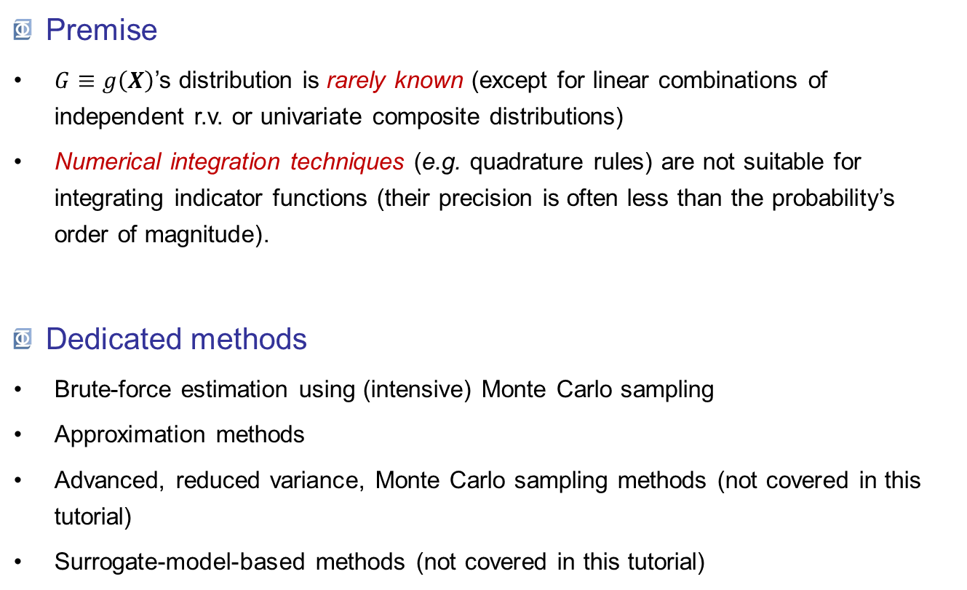
Problem definition
Premise
$G≡g\left(X\right)$’s distribution is rarely known (except for linear combinations of independent r.v. or univariate composite distributions)
Numerical integration techniques (e.g. quadrature rules) are not suitable for integrating indicator functions (their precision is often less than the probability’s order of magnitude).
Dedicated methods
Brute-force estimation using (intensive) Monte Carlo sampling
Approximation methods
Advanced, reduced variance, Monte Carlo sampling methods (not covered in this tutorial)
Surrogate-model-based methods (not covered in this tutorial)

Slide 8
Outline
Problem definition
Brute-force estimation using Monte Carlo sampling
Most-probable-failure-point(s)-based methods

Slide 9
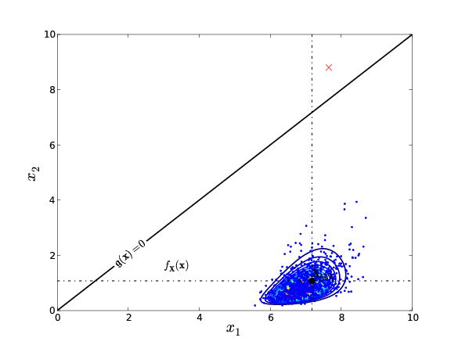









Brute-force Monte Carlo estimation
Principle
The crude Monte Carlo estimator of $p_{f}$is the empirical average of the Bernoulli failure experiment :
$${\hat{P}}_{f, MCS}=\frac{1}{N}\sum_{i=1}^{N}{𝕀_{𝔽}\left(X^{\left(i\right)}\right)}$$
where: $$𝕀_{𝔽}\left(X\right)∼ℬer\left(p_{f}\right)$$
$$f\left(i\right)$$
$${1−p}_{f}$$
$$p_{f}$$
$$i$$
$$0$$
$$1$$

Slide 10

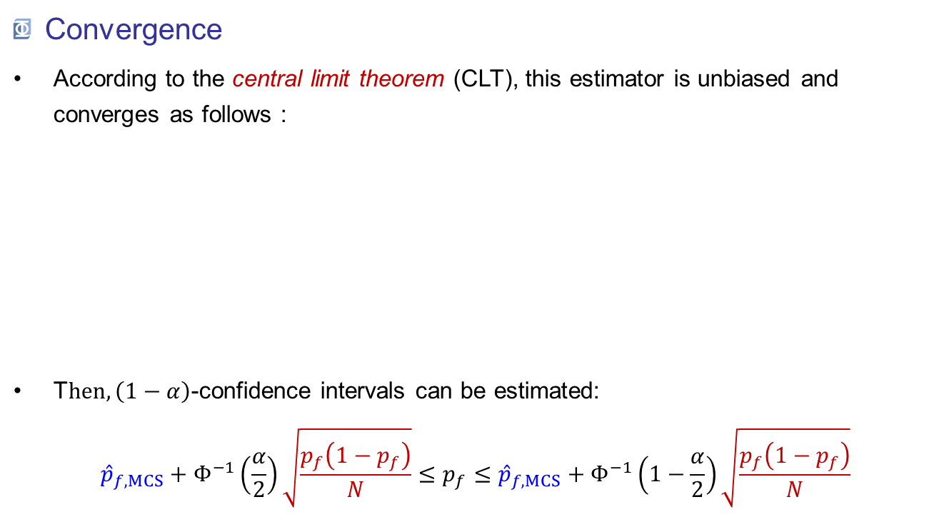

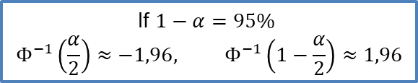
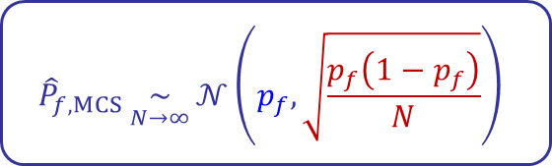
Brute-force Monte Carlo estimation
Convergence
According to the central limit theorem (CLT), this estimator is unbiased and converges as follows :
T$hen, \left(1−α\right)$-confidence intervals can be estimated: ${\hat{p}}_{f, MCS}+Φ^{−1}\left(\frac{α}{2}\right)\sqrt{\frac{p_{f}\left(1−p_{f}\right)}{N}}≤p_{f}≤{\hat{p}}_{f, MCS}+Φ^{−1}\left(1−\frac{α}{2}\right)\sqrt{\frac{p_{f}\left(1−p_{f}\right)}{N}}$
$${\hat{P}}_{f, MCS}\underset{N→∞}{∼}{𝒩\left(p_{f},\sqrt{\frac{p_{f}\left(1−p_{f}\right)}{N}}\right)}$$
Before applying the CLT, make sure that: $$\min\left\{Np_{f};N\left(1−p_{f}\right)\right\}≥10$$
If $1−α=95\%$
$$Φ^{−1}\left(\frac{α}{2}\right)≈−1,96, Φ^{−1}\left(1−\frac{α}{2}\right)≈1,96$$

Slide 11
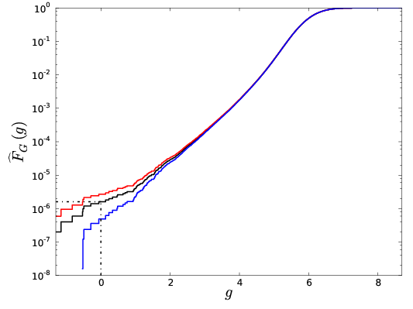
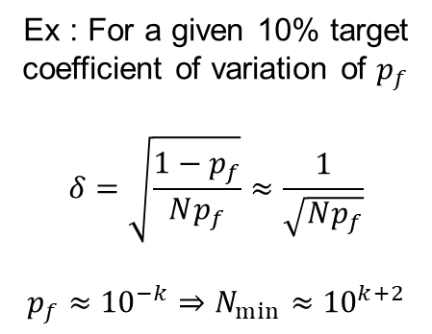

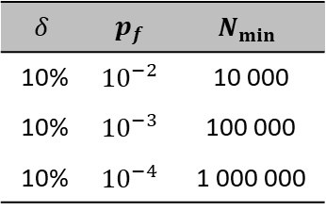

Brute-force Monte Carlo estimation
Convergence
The required sample size drastically increases as the probability gets low.
Ex : For a given 10% target coefficient of variation of $p_{f}$
$$δ=\sqrt{\frac{1−p_{f}}{Np_{f}}}≈\frac{1}{\sqrt{Np_{f}}}$$
$$p_{f}≈{10}^{−k}⇒N_{min}≈{10}^{k+2}$$
Coeff. of variation : $δ$ = std / mean
$$δ$$ | $$p_{f}$$ | $$N_{min}$$
10% | $${10}^{−2}$$ | 10 000
10% | $${10}^{−3}$$ | 100 000
10% | $${10}^{−4}$$ | 1 000 000
$${\hat{p}}_{f MCS}≈1,45×{10}^{−6}$$

Slide 12
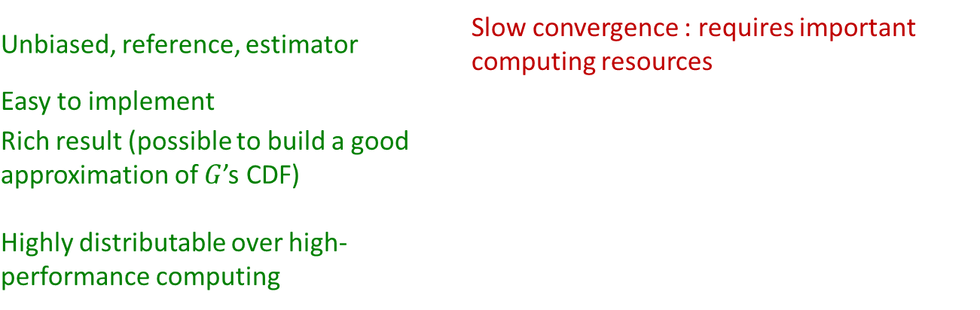
Brute-force Monte Carlo estimation
Pros & cons
Unbiased, reference, estimator | Slow convergence : requires important computing resources
Easy to implement
Rich result (possible to build a good approximation of $G$’s CDF)
Highly distributable over high-performance computing
When shoud it be used?
You don’t have cleverer choice
The performance function is fast to evaluate :
Simple closed-form expressions ;
HPC resources available.

Slide 13
Outline
Problem definition
Brute-force estimation using Monte Carlo sampling
Most-probable-failure-point(s)-based methods
Importance sampling
Isoprobabilistic transformation
Some methods

Slide 14
Most probable failure point(s)
Our goal
To estimate the probability of a failure (a rare event) efficiently
The idea
Transformation of the problem by :
Identifying most probable failure cases;
Modifying the sampling method to get more failures in the dataset.
Solutions
Importance sampling and isoprobabilistic transformations.

Slide 15
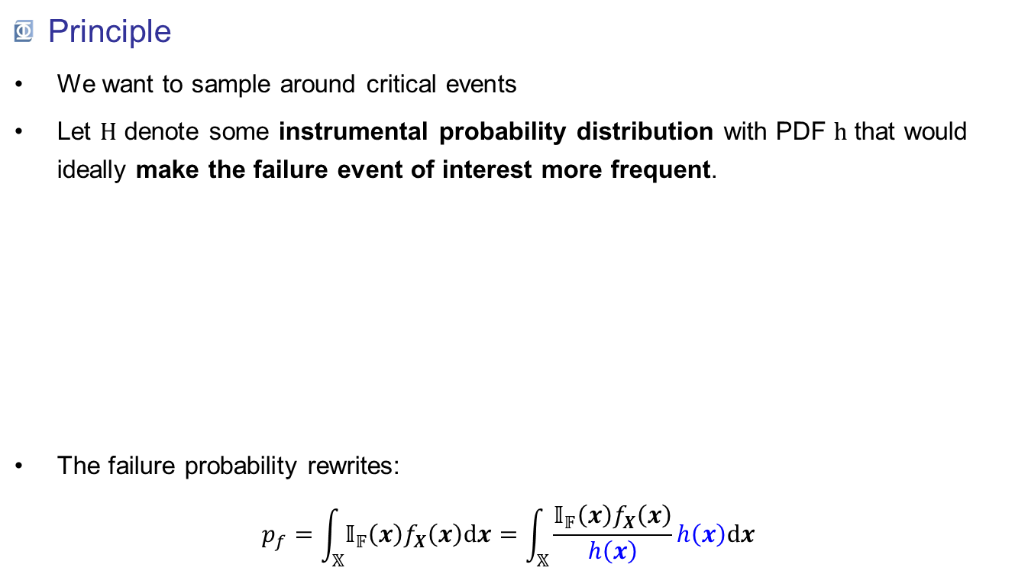




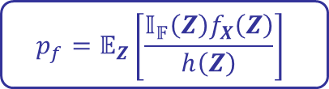
Importance sampling
Principle
We want to sample around critical events
Let $H$ denote some instrumental probability distribution with PDF $h$ that would ideally make the failure event of interest more frequent.
The failure probability rewrites: $p_{f}=\int_{𝕏}{𝕀_{𝔽}\left(x\right)f_{X}\left(x\right)dx}=\int_{𝕏}{\frac{𝕀_{𝔽}\left(x\right)f_{X}\left(x\right)}{h\left(x\right)}h\left(x\right)dx}$
$h$ must satisfy dominance condition $$h\left(x\right)=0 ⇒ 𝕀_{𝔽}\left(x\right)f_{X}\left(x\right)=0$$
density
Dominates $f_{X}$
Does not dominate $f_{X}$
$$x$$
$$p_{f}=𝔼_{Z}\left[\frac{𝕀_{𝔽}\left(Z\right)f_{X}\left(Z\right)}{h\left(Z\right)}\right]$$

Slide 16
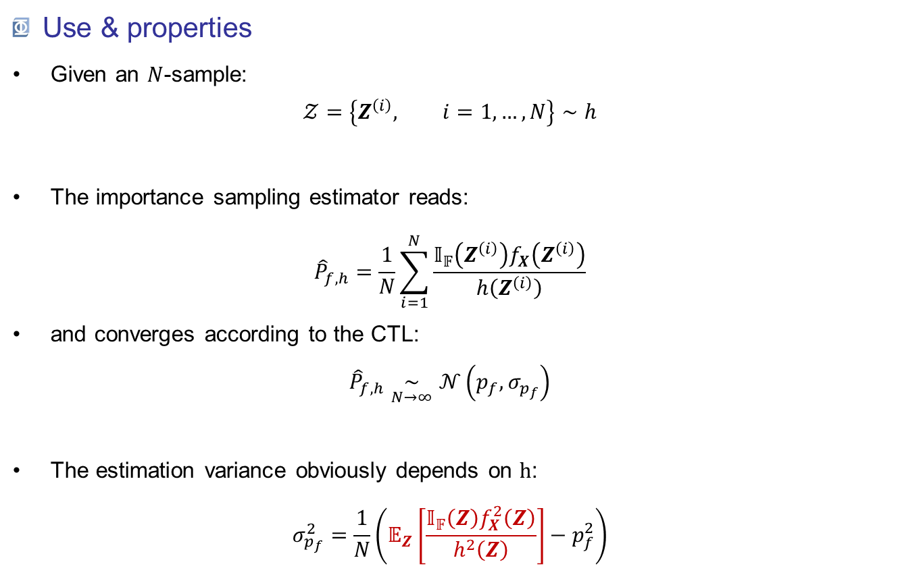
Importance sampling
Use & properties
Given an $N$-sample: $𝒵=\left\{Z^{\left(i\right)}, i=1,…,N\right\}∼h$
The importance sampling estimator reads: ${\hat{P}}_{f,h}=\frac{1}{N}\sum_{i=1}^{N}{\frac{𝕀_{𝔽}\left(Z^{\left(i\right)}\right)f_{X}\left(Z^{\left(i\right)}\right)}{h\left(Z^{\left(i\right)}\right)}}$
and converges according to the CTL: ${\hat{P}}_{f,h}\underset{N→∞}{∼}𝒩\left(p_{f},σ_{p_{f}}\right)$
The estimation variance obviously depends on $h$: $σ_{p_{f}}^{2}=\frac{1}{N}\left(𝔼_{Z}\left[\frac{𝕀_{𝔽}\left(Z\right)f_{X}^{2}\left(Z\right)}{h^{2}\left(Z\right)}\right]−p_{f}^{2}\right)$

Slide 17
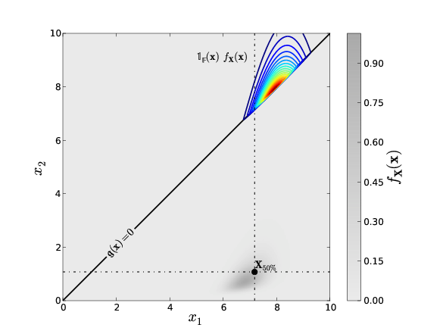
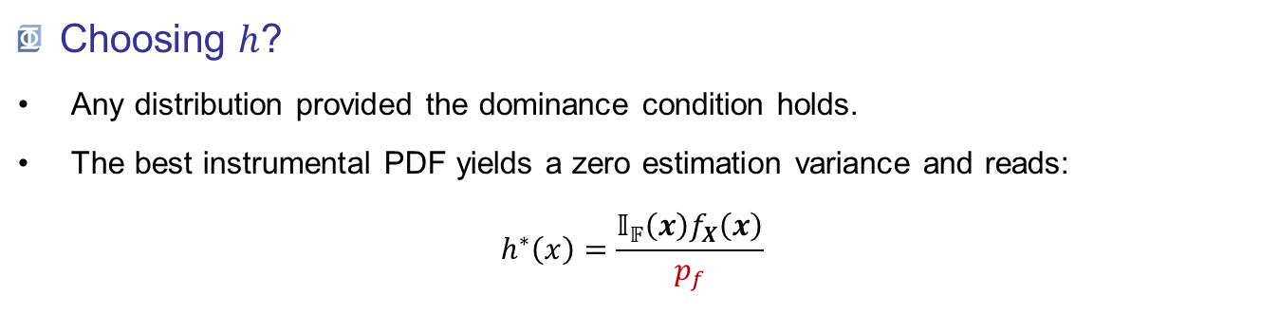
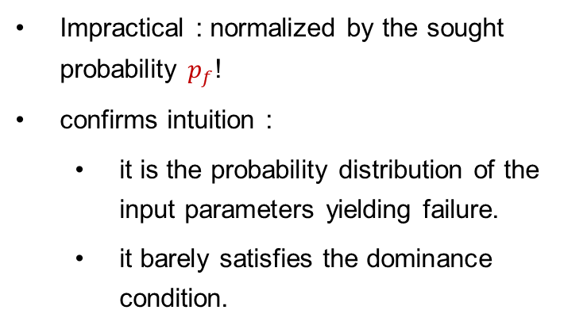
Importance sampling
Choosing $h$?
Any distribution provided the dominance condition holds.
The best instrumental PDF yields a zero estimation variance and reads: $h^{∗}\left(x\right)=\frac{𝕀_{𝔽}\left(x\right)f_{X}\left(x\right)}{p_{f}}$
Impractical : normalized by the sought probability $p_{f}$!
confirms intuition :
it is the probability distribution of the input parameters yielding failure.
it barely satisfies the dominance condition.

Slide 18
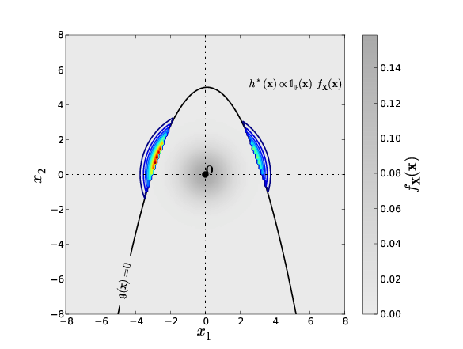
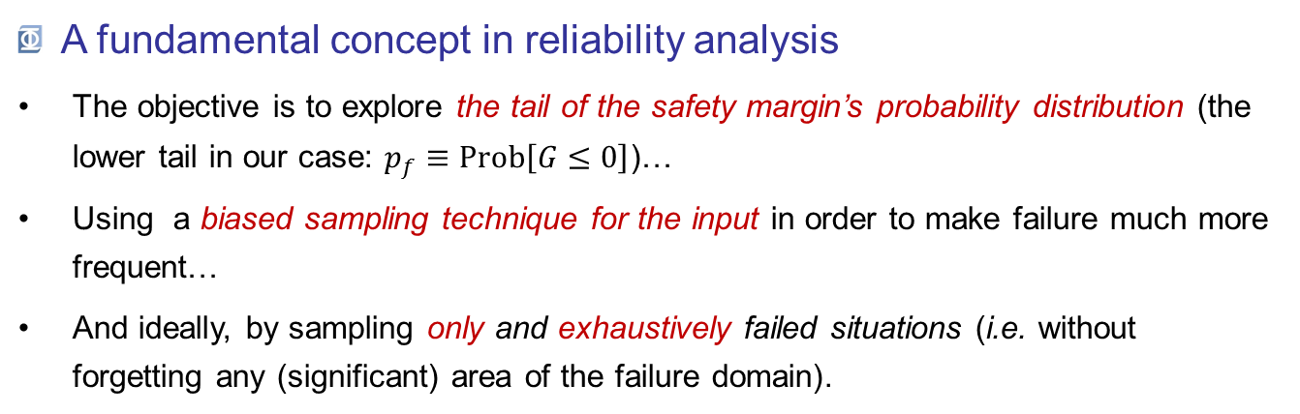
Importance sampling
A fundamental concept in reliability analysis
The objective is to explore the tail of the safety margin’s probability distribution (the lower tail in our case: $p_{f}≡Prob\left[G≤0\right]$)…
Using a biased sampling technique for the input in order to make failure much more frequent…
And ideally, by sampling only and exhaustively failed situations (i.e. without forgetting any (significant) area of the failure domain).

Slide 19
Outline
Problem definition
Brute-force estimation using Monte Carlo sampling
Most-probable-failure-point(s)-based methods
Importance sampling
Isoprobabilistic transformation
Some methods

Slide 20

Isoprobabilistic transformation
Motivation
G often follows a complex combination of heterogeneous marginals and copula, with no specific property.
On the contrary, gaussian distribution is well-known and has good properties.
Could we transform our composed distribution to a simpler one ?
$$⇒isoprobabilistic transformation$$

Slide 21
Isoprobabilistic transformation
Principle
Transformation from physical space to standard space
Conservation of probabilities
Available transformations
Type of copula | Transformation
Independent | Componentwise transformations
Elliptical | Generalized Nataf transformation
Any other | Rosenblatt transformation
The choice for the most-suitable transformation is automatic in OpenTURNS.
Further readings: Lebrun & Dutfoy (2009a,b,c)

Slide 22
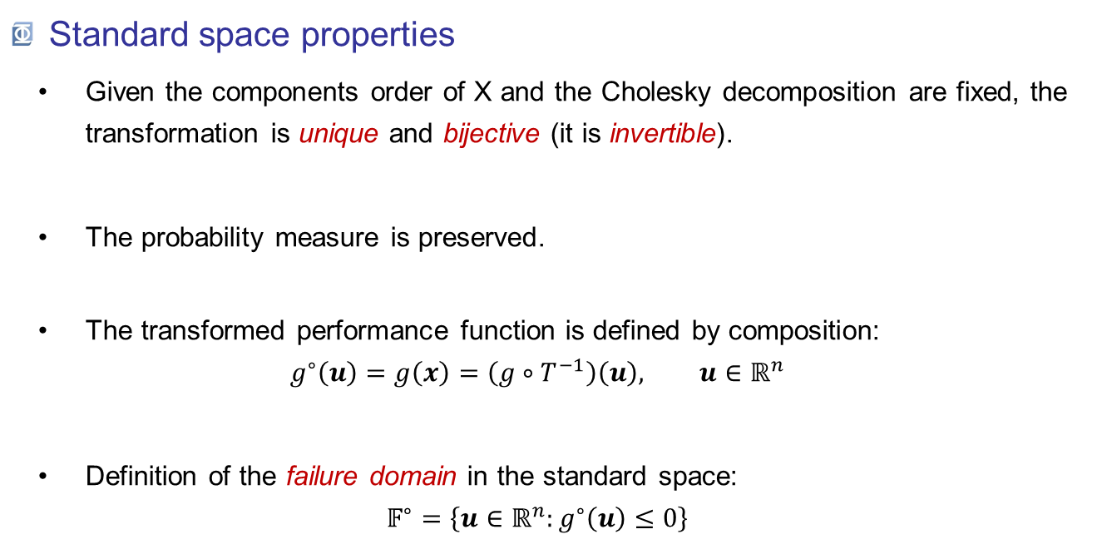
Isoprobabilistic transformation
Standard space properties
Given the components order of X and the Cholesky decomposition are fixed, the transformation is unique and bijective (it is invertible).
The probability measure is preserved.
The transformed performance function is defined by composition: $g^{∘}\left(u\right)=g\left(x\right)=\left(g∘T^{−1}\right)\left(u\right), u∈ℝ^{n}$
Definition of the failure domain in the standard space: $𝔽^{∘}=\left\{u∈ℝ^{n}:g^{∘}\left(u\right)≤0\right\}$
Does not hold for approximations

Slide 23
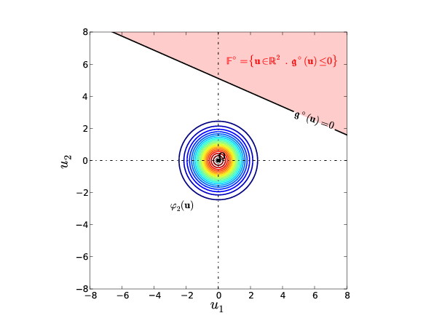
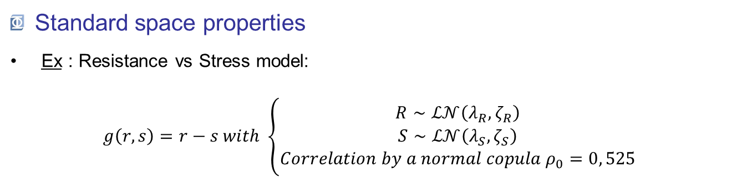
Isoprobabilistic transformation
Standard space properties
Ex : Resistance vs Stress model: $g\left(r,s\right)=r−s with \left\{\begin{aligned}R∼ℒ𝒩\left(λ_{R},ζ_{R}\right) \\ S∼ℒ𝒩\left(λ_{S},ζ_{S}\right) \\ Correlation by a normal copula{ ρ}_{0}=0, 525\end{aligned}\right.$
Physical space
Standard space

Slide 24
Outline
Problem definition
Brute-force estimation using Monte Carlo sampling
Most-probable-failure-point(s)-based methods
Importance sampling
Isoprobabilistic transformation
Some methods

Slide 25
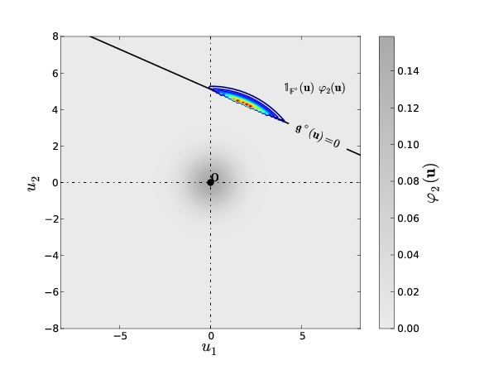


MPFP: FORM, SORM, P*-IS & FORM-$Σ$
Most probable failure point(s)
Let’s get back to the optimal importance sampling concept:
We define the most probable failure point(s) $u^{∗}$ as the mode(s) of the optimal instrumental distribution: $u^{∗}=\arg{\max_{u∈ℝ^{n}}{𝕀_{𝔽^{∘}}\left(u\right)φ_{n}\left(u\right)}}$
The solution is not nessarily unique, although it is often the case in many applications (e.g. in structural mechanics).
Physical space
Standard space

Slide 26
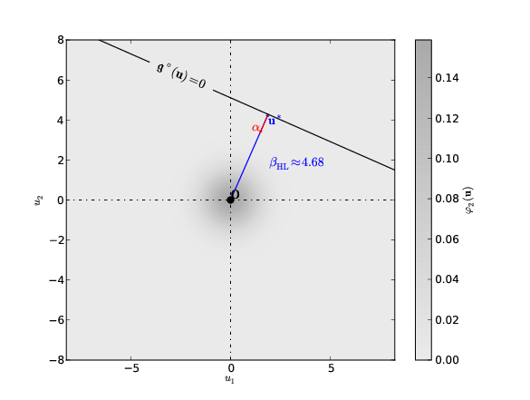

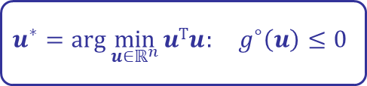
MPFP: FORM, SORM, P*-IS & FORM-$Σ$
Most probable failure point(s)
Let’s work on the definition: $u^{∗}=\arg{\max_{u∈ℝ^{n}}{𝕀_{𝔽^{∘}}\left(u\right)φ_{n}\left(u\right)}}$ = $\arg{\max_{u∈ℝ^{n}}{\frac{1}{{\left(2π\right)}^{n/2}}\exp\left(−\frac{1}{2}uTu\right): g^{∘}\left(u\right)≤0}}$
This is then equivalent to searching the failure point(s) in the standard space that are the closest to the origin.
$$u^{∗}=\arg{\min_{u∈ℝ^{n}}{uTu: g^{∘}\left(u\right)≤0}}$$

Slide 27
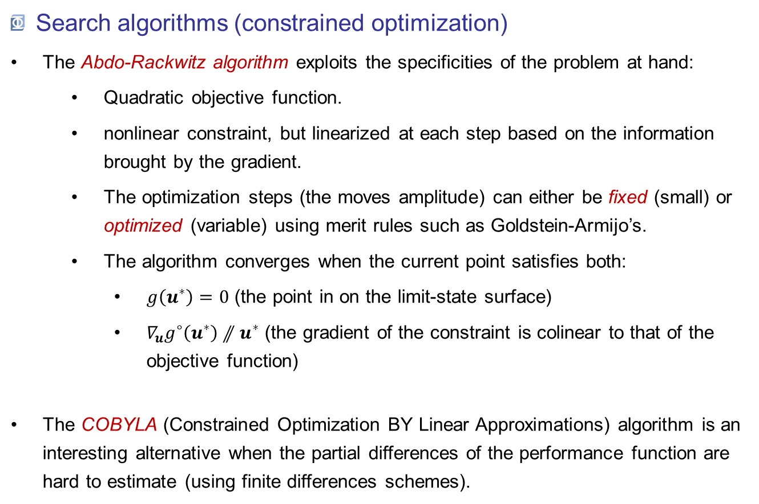
MPFP: FORM, SORM, P*-IS & FORM-$Σ$
Search algorithms (constrained optimization)
The Abdo-Rackwitz algorithm exploits the specificities of the problem at hand:
Quadratic objective function.
nonlinear constraint, but linearized at each step based on the information brought by the gradient.
The optimization steps (the moves amplitude) can either be fixed (small) or optimized (variable) using merit rules such as Goldstein-Armijo’s.
The algorithm converges when the current point satisfies both:
$g\left(u^{∗}\right)=0$ (the point in on the limit-state surface)
$∇_{u}g^{∘}\left(u^{∗}\right)⫽u^{∗}$ (the gradient of the constraint is colinear to that of the objective function)
The COBYLA (Constrained Optimization BY Linear Approximations) algorithm is an interesting alternative when the partial differences of the performance function are hard to estimate (using finite differences schemes).

Slide 28
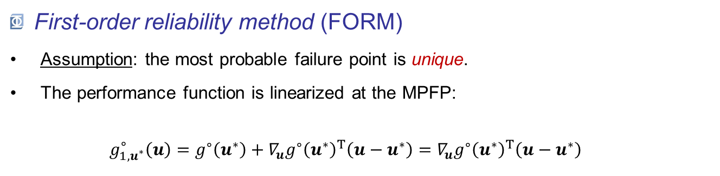

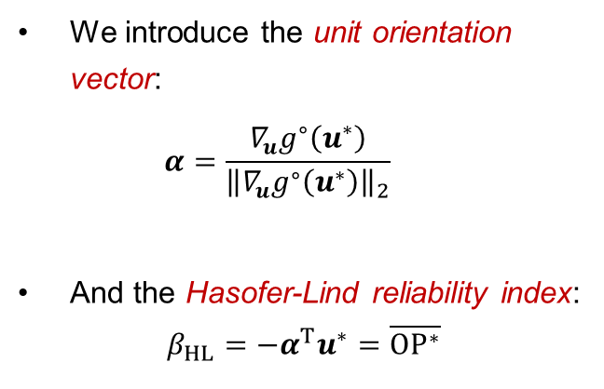
MPFP: FORM, SORM, P*-IS & FORM-$Σ$
First-order reliability method (FORM)
Assumption: the most probable failure point is unique.
The performance function is linearized at the MPFP: $g_{1,u^{∗}}^{∘}\left(u\right)=g^{∘}\left(u^{∗}\right)+{∇_{u}g^{∘}\left(u^{∗}\right)}^{T}\left(u−u^{∗}\right)={∇_{u}g^{∘}\left(u^{∗}\right)}^{T}\left(u−u^{∗}\right)$
We introduce the unit orientation vector: $α=\frac{∇_{u}g^{∘}\left(u^{∗}\right)}{{\left\|∇_{u}g^{∘}\left(u^{∗}\right)\right\|}_{2}}$
And the Hasofer-Lind reliability index: $β_{HL}=−α^{T}u^{∗}=\overline{OP^{∗}}$
$$P^{∗}$$

Slide 29

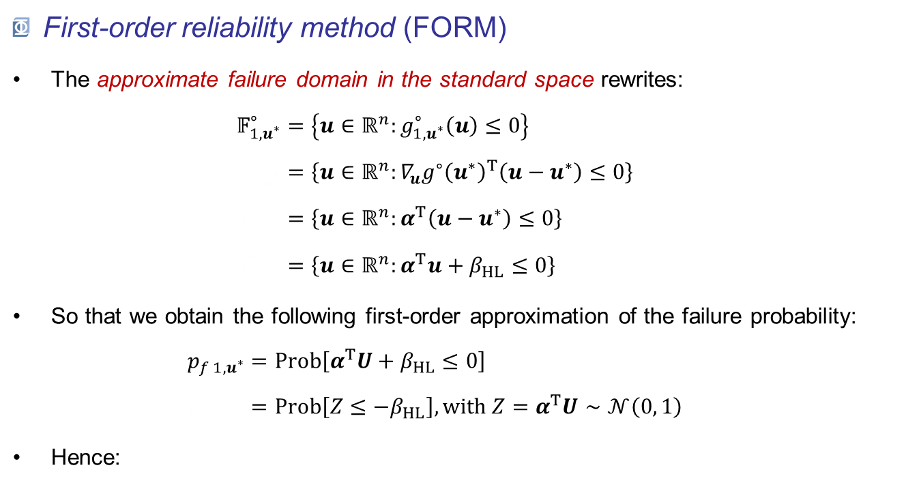
MPFP: FORM, SORM, P*-IS & FORM-$Σ$
First-order reliability method (FORM)
The approximate failure domain in the standard space rewrites: $𝔽_{1,u^{∗}}^{∘}=\left\{u∈ℝ^{n}:g_{1,u^{∗}}^{∘}\left(u\right)≤0\right\}$ $𝔽_{1,u^{∗}}^{∘}=\left\{u∈ℝ^{n}:{∇_{u}g^{∘}\left(u^{∗}\right)}^{T}\left(u−u^{∗}\right)≤0\right\}$ $𝔽_{1,u^{∗}}^{∘}=\left\{u∈ℝ^{n}:α^{T}\left(u−u^{∗}\right)≤0\right\}$ $𝔽_{1,u^{∗}}^{∘}=\left\{u∈ℝ^{n}:α^{T}u+β_{HL}≤0\right\}$
So that we obtain the following first-order approximation of the failure probability: $p_{f 1,u^{∗}}=Prob\left[α^{T}U+β_{HL}≤0\right]$ $p_{f 1,u^{∗}}=Prob\left[Z≤−β_{HL}\right],with Z=α^{T}U∼𝒩\left(0, 1\right)$
Hence:
$$p_{f 1,u^{∗}}=Φ\left(−β_{HL}\right)$$

Slide 30
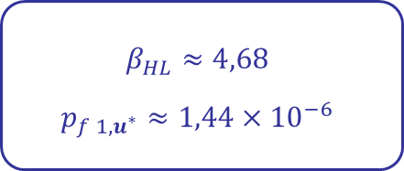
MPFP: FORM, SORM, P*-IS & FORM-$Σ$
First-order reliability method (FORM)
Ex: Resistance vs Stress model
$$β_{HL}≈4,68$$
$$p_{f 1,u^{∗}}≈1,44×{10}^{−6}$$
The limit-state surface being linear in the standard space, in this particular case, FORM is the reference solution.
Generally speaking, this is only an approximation.

Slide 31
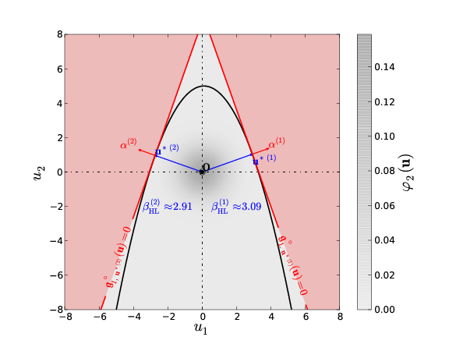
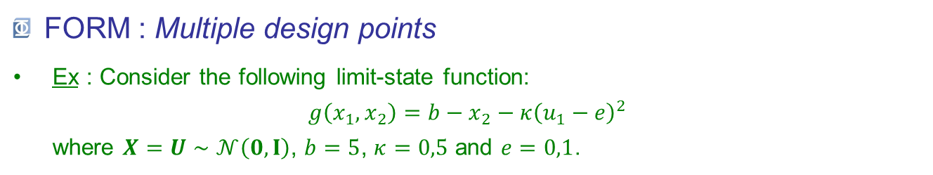
MPFP: FORM, SORM, P*-IS & FORM-$Σ$
FORM : Multiple design points
Ex : Consider the following limit-state function: $g\left(x_{1},x_{2}\right)={b−x}_{2}−κ{\left(u_{1}−e\right)}^{2}$ where $X=U∼𝒩\left(0,I\right)$, $b=5$, $κ=0,5$ and $e=0,1$.
See Der Kiureghian & Dakessian (1998).

Slide 32

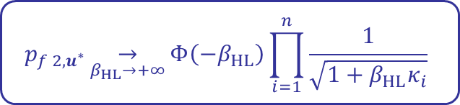
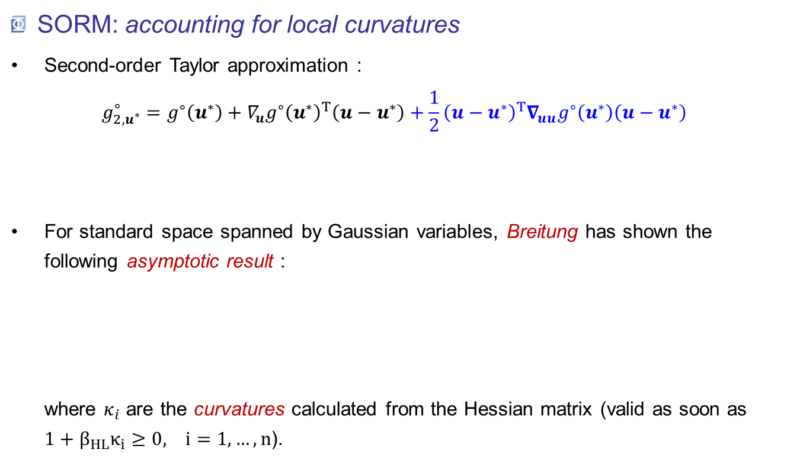
MPFP: FORM, SORM, P*-IS & FORM-$Σ$
SORM: accounting for local curvatures
Second-order Taylor approximation : $g_{2,u^{∗}}^{∘}=g^{∘}\left(u^{∗}\right)+{∇_{u}g^{∘}\left(u^{∗}\right)}^{T}\left(u−u^{∗}\right)+\frac{1}{2}{\left(u−u^{∗}\right)}^{T}∇_{uu}g^{∘}\left(u^{∗}\right)\left(u−u^{∗}\right)$
For standard space spanned by Gaussian variables, Breitung has shown the following asymptotic result : where $κ_{i}$ are the curvatures calculated from the Hessian matrix (valid as soon as $1+β_{HL}κ_{i}≥0, i=1,…, n$).
Assuming $∇_{uu}g^{∘}\left(u^{∗}\right)$ is computable
$$p_{f 2,u^{∗}}\underset{β_{HL}→+∞}{→}{Φ\left(−β_{HL}\right)\prod_{i=1}^{n}{\frac{1}{\sqrt{1+β_{HL}κ_{i}}}}}$$
Approx. Generalized by Lebrun & Dutfoy (2009a)

Slide 33
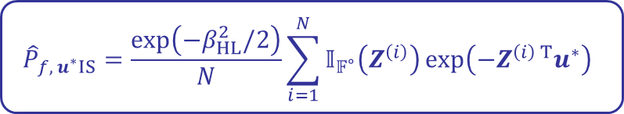
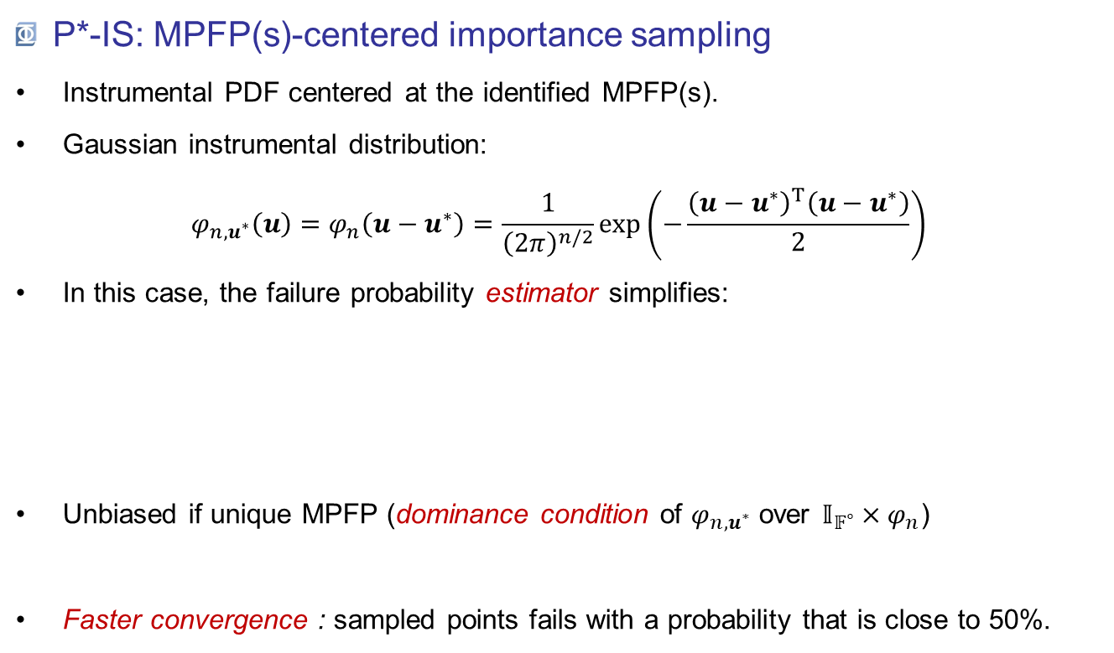
MPFP: FORM, SORM, P*-IS & FORM-$Σ$
P*-IS: MPFP(s)-centered importance sampling
Instrumental PDF centered at the identified MPFP(s).
Gaussian instrumental distribution: $φ_{n,u^{∗}}\left(u\right)=φ_{n}\left(u−u^{∗}\right)=\frac{1}{{\left(2π\right)}^{n/2}}\exp\left(−\frac{{\left(u−u^{∗}\right)}^{T}\left(u−u^{∗}\right)}{2}\right)$
In this case, the failure probability estimator simplifies:
Unbiased if unique MPFP (dominance condition of $φ_{n,u^{∗}}$ over $𝕀_{𝔽^{∘}}×φ_{n}$)
Faster convergence : sampled points fails with a probability that is close to 50%.
$${\hat{P}}_{f, u^{∗}IS}=\frac{\exp\left(−β_{HL}^{2}/2\right)}{N}\sum_{i=1}^{N}{𝕀_{𝔽^{∘}}\left(Z^{\left(i\right)}\right)\exp\left(−Z^{\left(i\right) T}u^{∗}\right)}$$

Slide 34
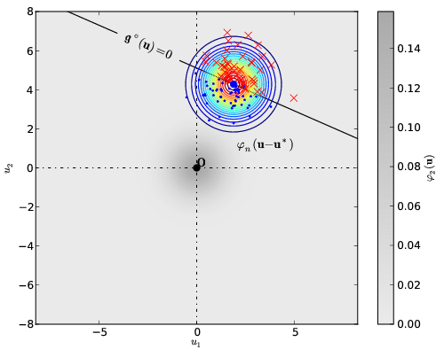
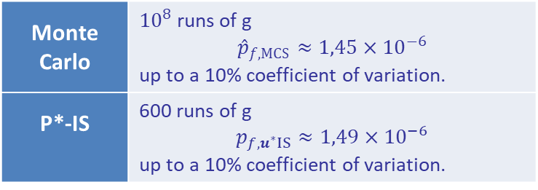
MPFP: FORM, SORM, P*-IS & FORM-$Σ$
P*-IS: MPFP(s)-centered importance sampling
Ex: Resistance vs Stress model
Monte Carlo | ${10}^{8}$ runs of g $${\hat{p}}_{f,MCS}≈1,45×{10}^{−6}$$ up to a 10% coefficient of variation.
P*-IS | 600 runs of g $$p_{f, u^{∗}IS}≈1,49×{10}^{−6}$$ up to a 10% coefficient of variation.

Slide 35
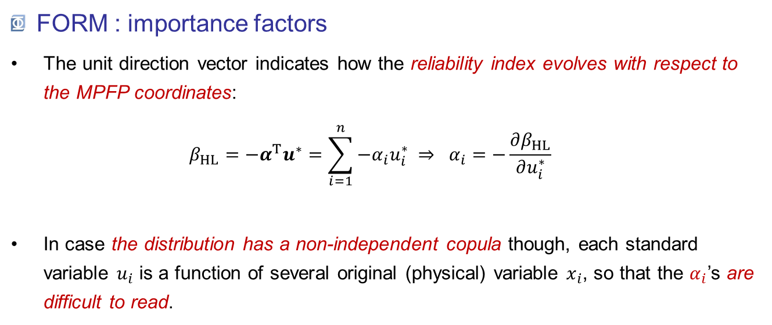
MPFP: FORM, SORM, P*-IS & FORM-$Σ$
FORM : importance factors
The unit direction vector indicates how the reliability index evolves with respect to the MPFP coordinates: $β_{HL}=−α^{T}u^{∗}=\sum_{i=1}^{n}{{−α}_{i}u_{i}^{∗}} ⇒ α_{i}=−\frac{∂β_{HL}}{∂u_{i}^{∗}}$
In case the distribution has a non-independent copula though, each standard variable $u_{i}$ is a function of several original (physical) variable $x_{i}$, so that the $α_{i}$’s are difficult to read.

Slide 36
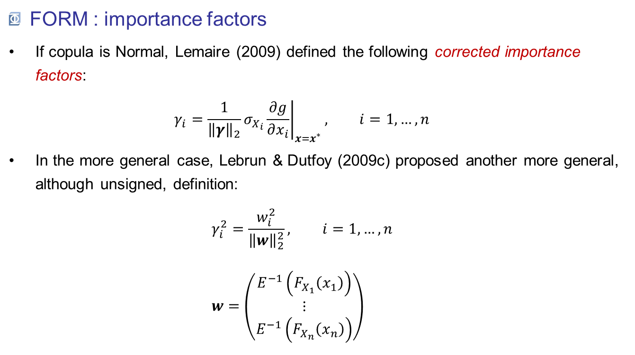
MPFP: FORM, SORM, P*-IS & FORM-$Σ$
FORM : importance factors
If copula is Normal, Lemaire (2009) defined the following corrected importance factors: $γ_{i}=\frac{1}{{\left\|γ\right\|}_{2}}σ_{X_{i}}{\left.\frac{∂g}{∂x_{i}}\right|}_{x=x^{∗}}, i=1,…,n$
In the more general case, Lebrun & Dutfoy (2009c) proposed another more general, although unsigned, definition: $γ_{i}^{2}=\frac{w_{i}^{2}}{{\left\|w\right\|}_{2}^{2}}, i=1,…,n$ $w=\left(\begin{aligned}E^{−1}\left(F_{X_{1}}\left(x_{1}\right)\right) \\ ⋮ \\ E^{−1}\left(F_{X_{n}}\left(x_{n}\right)\right)\end{aligned}\right)$

Slide 37
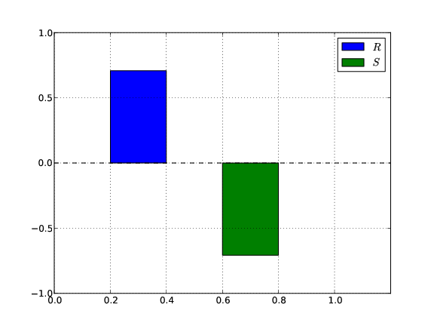
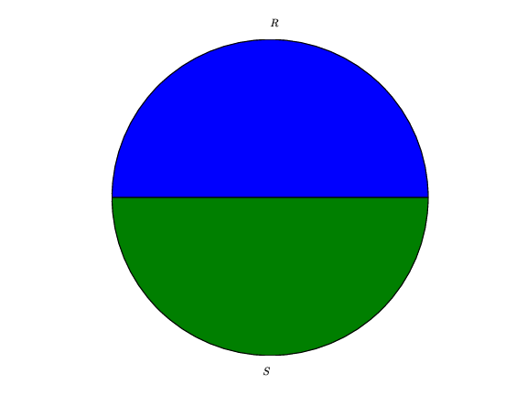



MPFP: FORM, SORM, P*-IS & FORM-$Σ$
FORM : importance factors
These results are often presented in either one or both of these two charts:
$$γ_{i}^{2}$$
$$γ_{i}$$
Signed bar chart $α_{i}$ or $γ_{i}$ positive $⇒X_{i}$ is a capacity variable $α_{i}$ ot $γ_{i}$ negative $⇒X_{i}$ is a demand variable
Pie chart The quadratic sum equals 1. Qualitative comparison of the importance of variables
w.r.t. failure.

Slide 38


MPFP: FORM, SORM, P*-IS & FORM-$Σ$
FORM-$Σ$ : Serial combination of linear limit-states
Input: for the $n_{P^{∗}}$ identified MPFPs :
reliability indices: $β_{HL}=\left(β_{HL}^{\left(i\right)}, i=1,…,n_{P^{∗}}\right)$
importance factors in the standard space: $Α=\left(α^{\left(i\right)}, i=1,…,n_{P^{∗}}\right)$
Objective : combine these results into a single probability, the one associated to the serial system formed by the contributors.
Solution: where: $ρ_{ij}=α^{\left(i\right) T}α^{\left(j\right)}, i,j=1,…, n_{P^{∗}}$ are the « pairwise limit-states’ correlation » ($−1≤ρ≤1$).
$$p_{f, 1Σ}=Prob\left[U∈\bigcup_{i=1}^{n_{P^{∗}}}{\left\{u∈ℝ^{n}:α^{\left(i\right) T}u+β_{HL}^{\left(i\right)}≤0\right\}}\right]={1−Φ}_{n_{P^{∗}}}\left(β_{HL};0,ρ\right)$$

Slide 39


MPFP: FORM, SORM, P*-IS & FORM-$Σ$
FORM-$Σ$ : Serial combination of linear limit-states
Ex : Consider the following limit-state function: $g\left(x_{1},x_{2}\right)={b−x}_{2}−κ{\left(u_{1}−e\right)}^{2}$ where $X=U∼𝒩\left(0,I\right)$, $b=5$, $κ=0,5$ and $e=0,1$.
The correlation between the two limit-states is:
$$ρ_{12}=α^{\left(1\right) T}α^{\left(2\right)}≈−0,78$$
Hence the first-order approximation of the serial system failure probability is: $$p_{f1,Σ}=1−Φ_{2}\left(\left(\begin{aligned}3,09 \\ 2,91\end{aligned}\right);0,\left[\begin{matrix}1 & −0,78 \\ −0,78 & 1\end{matrix}\right]\right) \\ p_{f1,Σ}≈2,82×{10}^{−3}$$ The crude Monte Carlo estimate is: $${\hat{p}}_{f,MCS}≈3,12×{10}^{−3}$$
Up to a 10% coefficient of variation.

Slide 40

MPFP: FORM, SORM, P*-IS & FORM-$Σ$
Pros & Cons
Coordinates : singular configuration(s) of the system. | non-unicity risk (FORM, SORM & basic P*-IS)
Importance factors : clues for improving reliability. | non-completeness risk (FORM-$Σ$)
Affordable computational cost. | Missing (FORM, SORM, FORM-$Σ$) or subjective (P*-IS) error metric
When should it be used?
As a first approximation ;
Confirmed by an expert judgement about the identified failure modes.

Slide 41

Conclusions
Reliability methods aim at estimating the safety level attached to a component in the form of a subjective failure probability :
Crude Monte Carlo sampling
Model exploration, no assumption, expensive.
Most-probable-failure-point(s)-based techniques
cheaper (even if HPC may still help) but assumptions and approximations.
deeper investigation of the system (MPFP coordinates, importance factors).
$$p_{f}=Prob\left[failure∣model\right]$$

Slide 42
Further readings
Ditlevsen, O. & Madsen, H. (1996). Structural reliability methods. John Wiley & Sons.
Lebrun, R. & Dutfoy, A. (2009a). A generalization of the Nataf transformation to distributions with elliptical copula. Prob. Eng. Mech., 24, 172–178.
Lebrun, R. & Dutfoy, A. (2009b). An innovating analysis of the Nataf transformation from the copula viewpoint. Prob. Eng. Mech., 24, 312–320.
Lebrun, R. & Dutfoy, A. (2009c). Do Rosenblatt and Nataf isoprobabilistic transformations really differ? Prob. Eng. Mech., 2009, 24, 577–584.
Lemaire, M. (2009). Structural reliability. Wiley. 480 pp.

